Slide 1
Opportunities and benefits of the ALFRED demonstrator
ALFRED Research Infrastructure: Looking ahead
October 22-23, 2020
 | Michele Frignani
 | Tendering and Technical Integration – Head of Unit Member of Expert Board, FALCON Consortium
Corso F. M. Perrone, 25
16152 Genoa – Italy | Phone: +39 010 655 8094
www.ansaldonucleare.it | michele.frignani@ann.ansaldoenergia.com

Slide 2
Facts and Forecasts
9.7 billion people by 2050
2/3 of the world’s people living in urban areas
1,7% increase of CO₂ in 2018
70% higher than average increase since 2010
25% global energy increase by 2040
2 times faster electricity demand increase
2.8% RES increase per year
RES will provide 31% of electricity generation by 2040

Slide 3
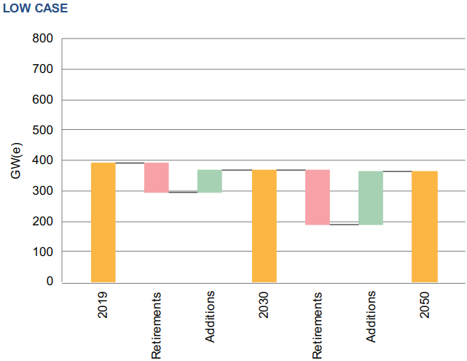
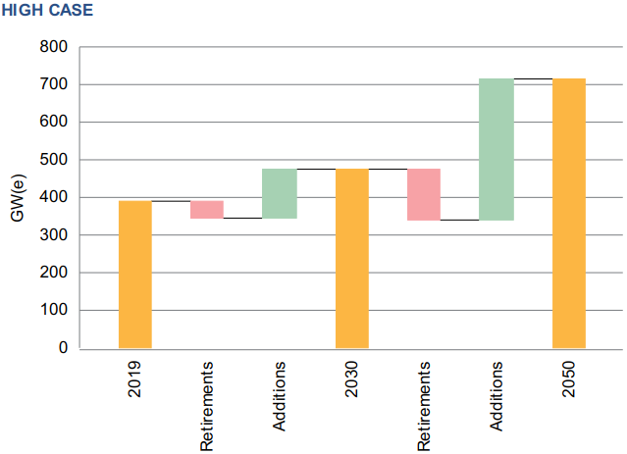
Facts and forecasts
World
7713
million people
25 602TWh
of electricity produced
10.4%
from nuclear

Slide 4
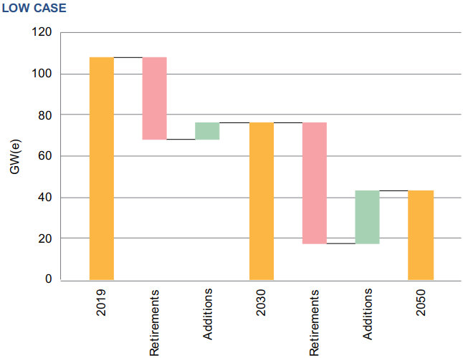
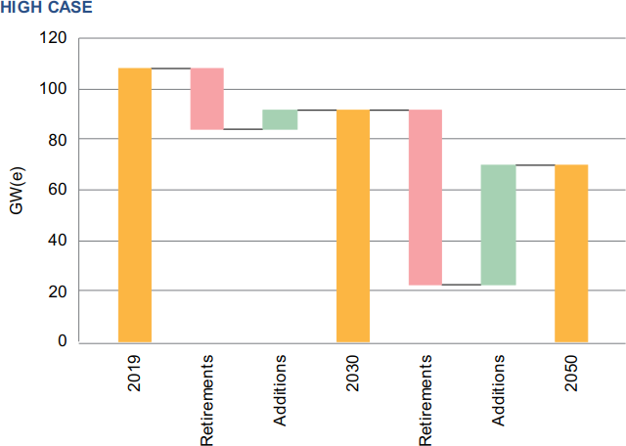
Facts and forecasts
Northern, Western and
Southern Europe
454
million people
2 989 TWh
of electricity produced
24.2%
from nuclear

Slide 5
The «ideal» Nuclear Power Plant
100% usage of resources
No carbon emissions in operation
No offsite emergency
No long-lived waste
Cheap electricity
High reliability

Slide 6
ALFRED: the Advanced Lead-cooled Fast Reactor European Demonstrator
No other advanced reactor technology can feature the same unique aspects
One of the most promising technologies for deployment in the SMR segment
Steadily increasing attention by industry and utilities worldwide
Recognized by inclusion in the research agendas at international level (GIF, ESNII)
ALFRED, a demonstration reactor, also prototypic of a Lead-based SMR, to bridge the final gap between conducted research and industrial application

Slide 7
A world-class Research Infrastructure
The largest pool facility in the world, for large-scale in rep-resentative conditions
A broad-scope laboratory on the chemistry of HLMs and materials science
ATHENA
ChemLab
A hot facility to characterize radioisotopes behavior in Lead under accident conditions
A pool facility for
long-term experiments,
to characterize the components and systems
Meltin’Pot
ELF
HELENA-2
Hands-ON
A loop facility for full-scale
testing complete thermal-hydraulic characterization of
fuel elements
A facility devoted to the testing and qualification of systems and procedures for the handling of core elements

Slide 8
Research Infrastructure: Science and Technology development
Develop the HLM science
Demonstrate the LFR technology
Deploy a world-class research infrastructure
Provide industrial qualification services
Pool the European research community
Support LFR safe and sustainable operation
Science
Technology
Notes:
A specific focus will be maintained on the scientific aspects of dealing with heavy liquid metals, ranging from the physics and chemistry of Lead and Lead-alloys to materials science, and reactor physics.
The research infrastructure will complement the current landscape of existing facilities in Europe towards excellence, extending the scope of the studies performed to larger scale and multi-physics.
The management policies of the infrastructure will build on the surrounding context to strengthen the European community, promoting collaboration and joint programming, also by offering open-access and calls for excellence.
The technology advancement will be first of all materialized by the construction and successful operation of the ALFRED demonstrator, proving all the claimed features to the largest extent.
In support to ALFRED construction and later of follow-on LFRs, the infrastructure will represent a unique environment to provide services to industry, for the qualification of innovative solutions and procedures for use in nuclear systems, as well as in any other field exploiting the technology of Lead.
Overall, the joint access of academia, research, industry and safety authorities to the infrastructure will establish a joint framework for the collaborative development of new standards, continuously enhancing the safety and sustainability level of LFRs.

Slide 9
Role of the Research Infrastructure
To support the final design and licensing of the ALFRED reactor
To provide a comprehensive platform to master the LFR technology
To support a staged approach for the further advancement of the LFR technology
To continuously enhance the safety and sustainability performances of following commercial units

Slide 10
FALCON: A long-lasting collaboration endeavor
Fuel-coolant chemistry
Coatings development
Engineering support
CFD analysis
CFD analysis
Operator’s review
Balance of Plant optimization
Manufacturing feasibility
Analysis and E&T
CESINA Partnership

Slide 11
A challenging roadmap…
Viability
Preparation
Construction
Operation
2020
2025
2030

Slide 12
…on a solid basis
2011
2016 - National Energy Strategy
2017 - National Strategy for RDI and National Plan for RDI (2015-2020)
2017 - Public statement by Prime Minister to support part of the total cost
2018 - ESNII Exec Board promoted ALFRED in the Fast Track
2019 - Romania National Research Plan 2015-2020 (ALFRED included)
Availability of Romania to host ALFRED
2015
ALFRED in Smart Specialization Strategy of South-Muntenia
2018
National strategy for Romania sustainable development
Jun.2020
Green-light on ATHENA and ChemLab construction
~12 MLei for 2019-2020 for National R&I plan on ALFRED (PRO-ALFRED)

Slide 13
Opportunities and benefits
European Level
National Level
Reduce disparities and consolidate European leadership in nuclear technology
Regional Level
An opportunity for Romania to become the focal point in the LFR technology in Europe
Local Level
ALFRED included in the Smart Specialization Strategy of South Muntenia
Increased visibility and reputation recognized by local community
Economic competitiveness of the industrial reactors is one of the main drivers of the Project.
Competitiveness cannot be the case for the research infrastructure, and notably for ALFRED.
Economic worthwhileness can be demonstrated if socio-economic impacts are factored in.
Short- and long-term scientific relevance and social benefits are key factors.
A combination of public and private funds is the means for project success.

Slide 14
Copyright © 2020 – FALCON
This presentation contains proprietary and confidential data, information and formats. All rights reserved.
No part of this presentation may be reproduced, distributed, or transmitted in any form or by any means, including photocopying, recording, or other electronic or mechanical methods, without the prior written permission of FALCON.
The seminar is prepared and supplied within the PRO ALFRED project

